Slide 2
Starting Nestor OS Pi…

Slide 3


Nestor Page
Nestor Page
Nestor OS Pi 5
© 2014 – 2019 Nestor Page
Notes:
<número>

Slide 4


Slide 6
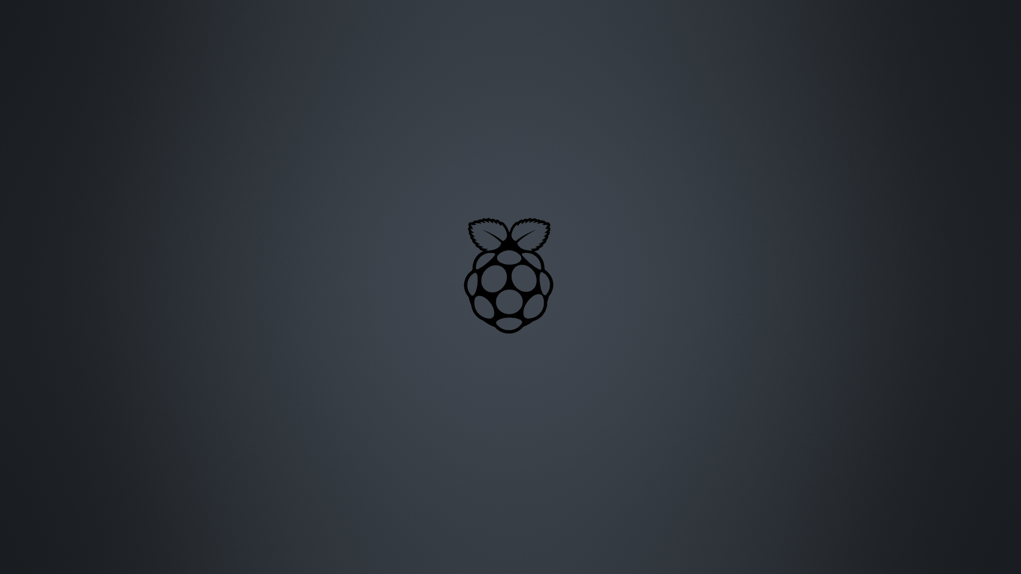

Slide 8










Nestor OS Desktop
Turn Off…

Slide 9
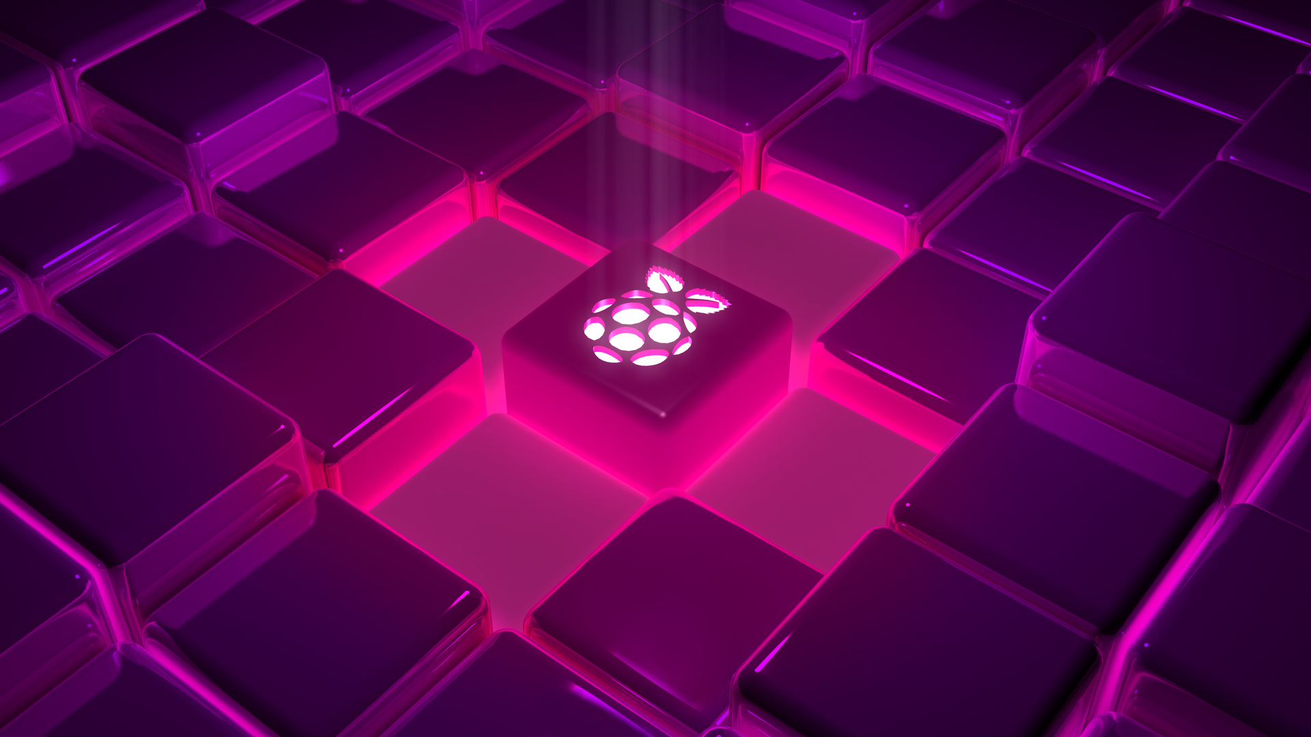
Nestor OS Desktop
Turn Off…

Slide 10
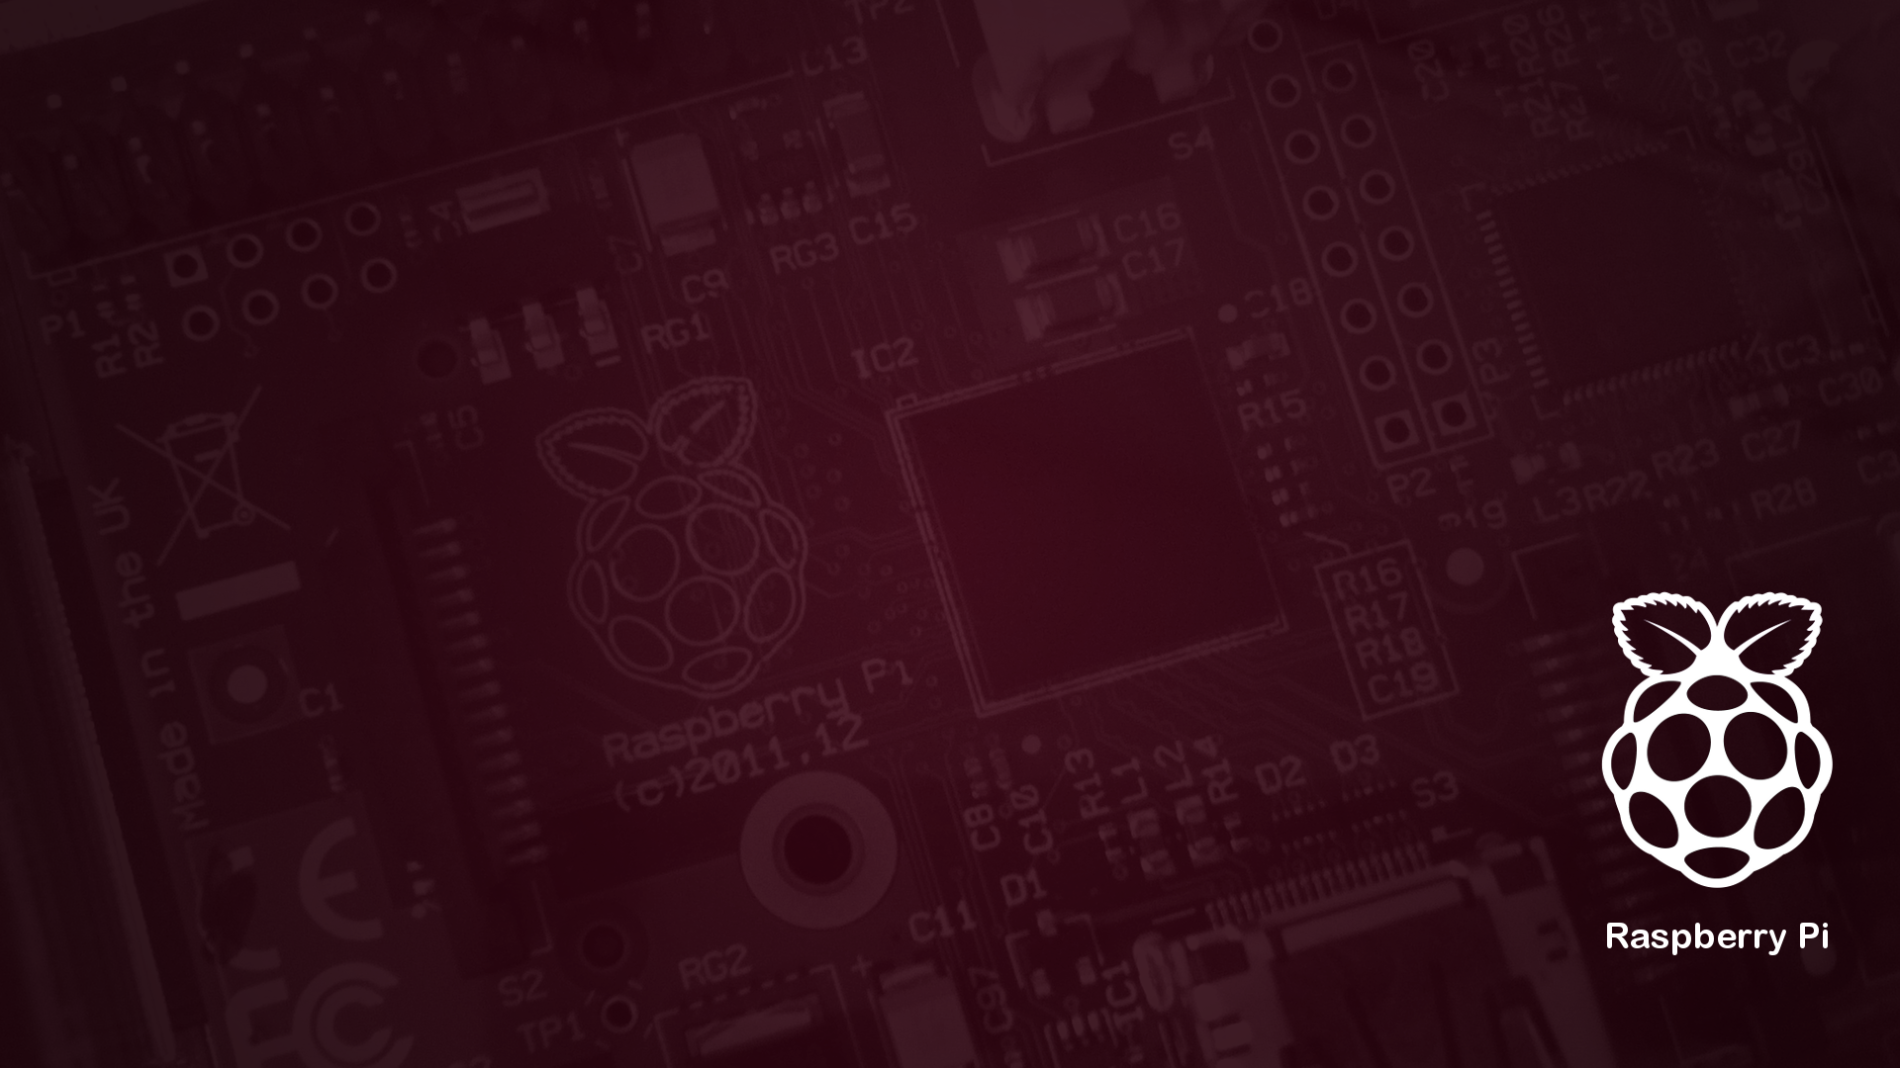
Nestor OS Desktop
Turn Off…

Slide 11
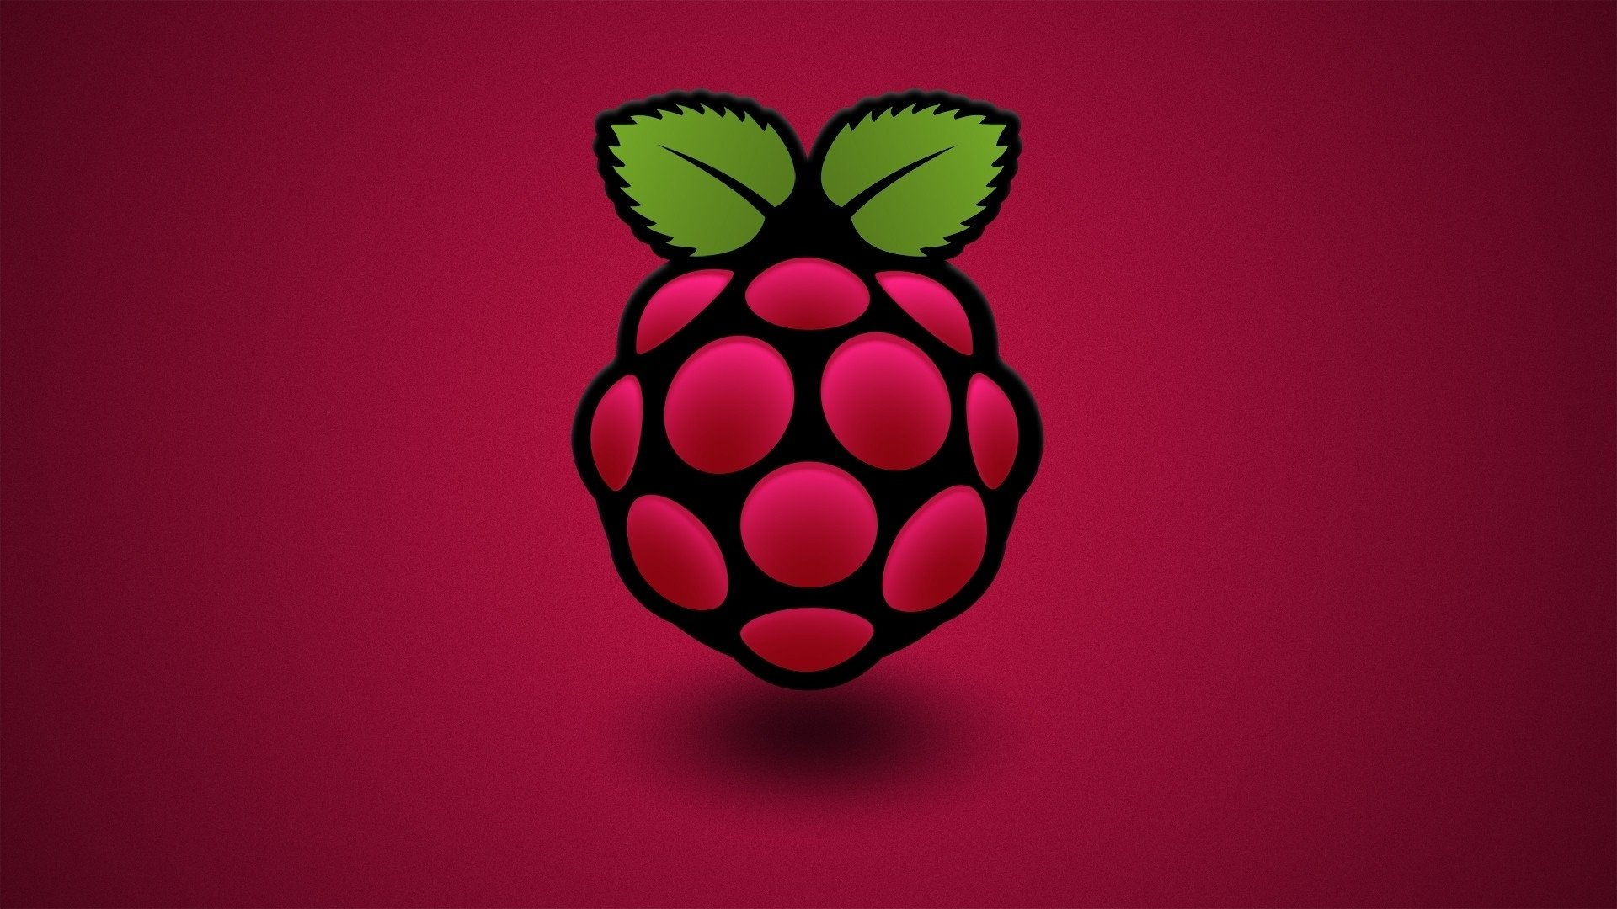

Nestor OS Desktop
Turn Off…

Slide 12
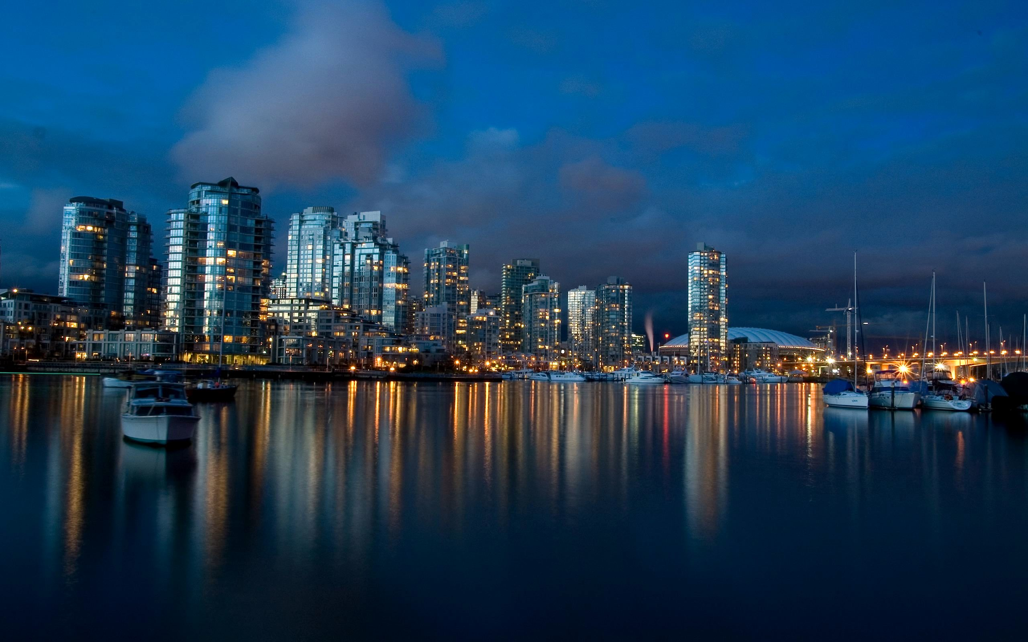

Nestor OS Desktop
Turn Off…

Slide 13
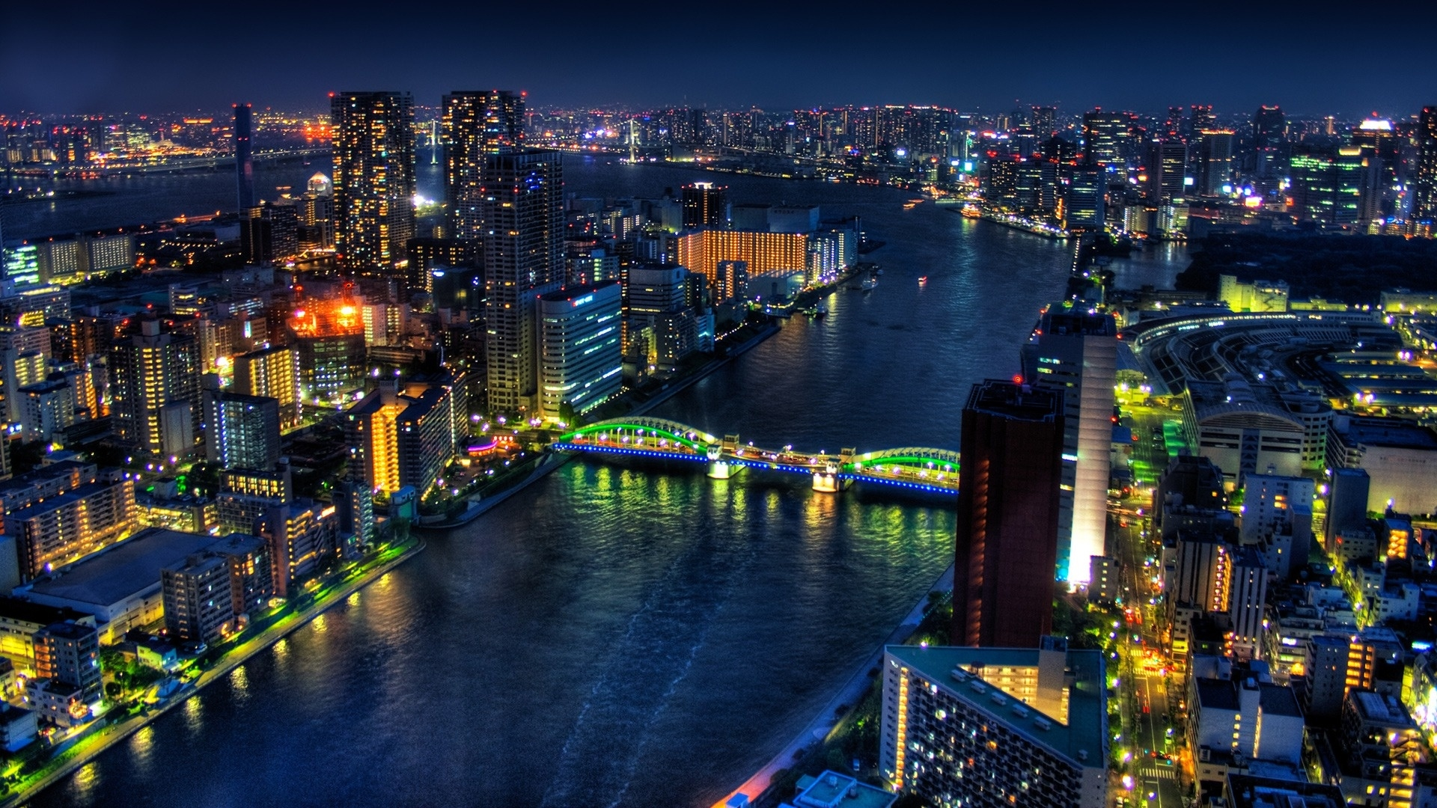

Nestor OS Desktop
Turn Off…

Slide 14
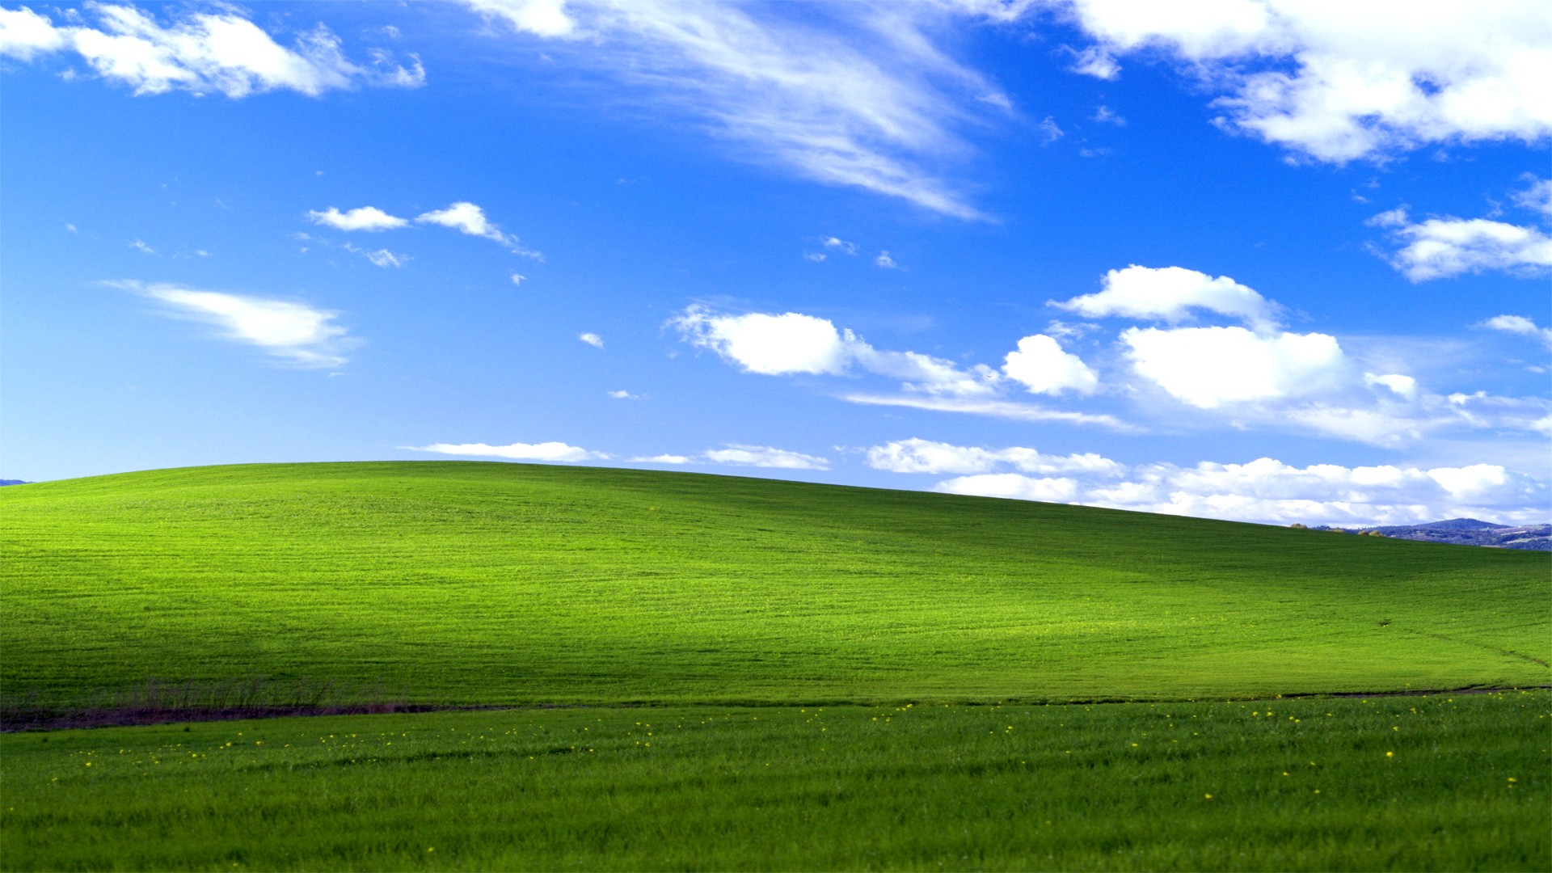
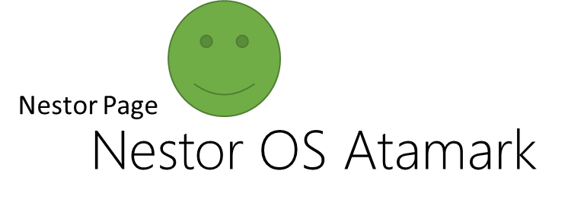
Nestor OS Desktop
Turn Off…

Slide 15


File Explorer
This PC
My PC
C: PI
4GB free of 16GB
Notes:
<número>

Slide 16
File Explorer
My PC
C: PI
4GB free of 16GB
Notes:
<número>

Slide 17
File Explorer
There are no files in the Recycle Bin.
Recycle Bin
Notes:
<número>

Slide 18
File Explorer
There are no files in the Recycle Bin.
Notes:
<número>

Slide 19
File Explorer
The Files are hidden. It can be found in the Linux subsystem
File Explorer
C:\ PI
Notes:
<número>

Slide 20
File Explorer
The Files are hidden. It can be found in the Linux subsystem
C:\ PI
Notes:
<número>

Slide 21

Nestoria
Hi. Im Nestoria. What i can do for you?
Who are you?
Open File Explorer
I want to watch a video
Restart the PC
What nestorOS version im running?
Turn off the PC
I want to watch a picture
I want to see if there are more programs
I want to listen to music
Goodbye!
Change the wallpaper
I want to watch the news

Slide 22
Nestoria
Im Nestoria, the exclusive personal assistant for
nestorOS
Ask other thing

Slide 23
Nestoria
You can find the programs when you exit Nestoria
Ask other thing

Slide 24
About this OS
About this OS
Nestor Page
Nestor OS Pi 5
PC Name: Pi
Language: English
Version: Pi 5
Build: 2978
Processor: ARM Cortex A53 @1.2GHz
RAM: 1GB (LPDDR2)
64-Bit OS, ARMv8 architecture
© 2013 – 2019 Nestor Page.
Notes:
<número>

Slide 25
About this OS
Nestor Page
Nestor OS Pi 5
PC Name: Pi
Language: English
Version: Pi 5
Build: 2978
Processor: ARM Cortex A53 @1.2GHz
RAM: 1GB (LPDDR2)
64-Bit OS, ARMv8 architecture
© 2013 – 2019 Nestor Page.
Notes:
<número>

Slide 26
Musify 5.1
Music in This PC
Cardi B – I like it
2018
Awolnation - Run
2015
Europe – The Final Countdown
1986

Slide 27
Musify 5.1
Music in This PC
Cardi B – I like it
2018
Awolnation - Run
2015
Europe – The Final Countdown
1986

Slide 28
Musify 5.1
Music in This PC
Cardi B – I like it
2018
Awolnation - Run
2015
Europe – The Final Countdown
1986

Slide 29
Musify 5.1
Music in This PC
Cardi B – I like it
2018
Awolnation - Run
2015
Europe – The Final Countdown
1986

Slide 30
Filmify 5.1
Videos in This PC
No videos found

Slide 31

Imagify 5.1
Images in This PC
pi1.jpg
pi2.jpg
nature.jpg
Full View

Slide 32


Imagify 5.1 (Full View)
pi1.jpg

Slide 33
Imagify 5.1 (Full View)
pi2.jpg

Slide 34
Imagify 5.1 (Full View)
nature.jpg

Slide 35
Nestor OS News
Nestor OS News
Nestor Page admits the nestorOS 19.04 RTM failure.
How the downloads did increase?
July 19th 2019: nestorOS 19.04 wasn’t going good as expected. The apps were
criticized, and some features too.
A feature update was released on June 5th 2019, where all these errors were fixed, and
as of July 18th 2019, it has got 86 downloads by itself, and with the RTM, 147 downloads.
It was also premiered in YouTube, increasing the downloads and because of that,
30-36 of the downloads of the revision of the wireframe comes from YouTube, and also
comes from Discord
Notes:
<número>

Slide 36
Nestor OS News
Nestor Page admits the nestorOS 19.04 RTM failure. How the downloads did increase?
July 19th 2019: nestorOS 19.04 wasn’t going good as expected. The apps were criticized, and some features too.
A feature update was released on June 5th 2019, where all these errors were fixed, and as of July 18th 2019, it has got 86 downloads by itself, and with the RTM, 147 downloads. It was also premiered in YouTube, increasing the downloads and because of that, 30-36 of the downloads of the revision of the wireframe comes from YouTube, and also comes from Discord
Notes:
<número>

Slide 37


Turn Off the Computer
Turn Off
What do you want to do?
Turn Off
Restart
Cancel

Slide 38
Nestor OS Desktop

Slide 41
Nestor Page
Nestor OS Pi 5
Nestor OS Pi is shutting down...
Notes:
<número>

Slide 43
It is now safe to turn off your computer

